Slide 1


8th Semester Project (UDP-3180701)
Trippify Commute with your colleagues
Submitted to
Computer department, L.D. College of Engineering
Prepared by Supervised by
Jignasa Dabhi(190280107023) Dr. Prof. Hetal A. Joshiara
Srushti Nayak(190280107081)

Slide 2

Outline
Introduction
Limitations of existing systems
Proposed solution
Objectives
Functionality
Tools and technology
Highlights of our work
Snapshots of work
Conclusion & Future work
References

Slide 3
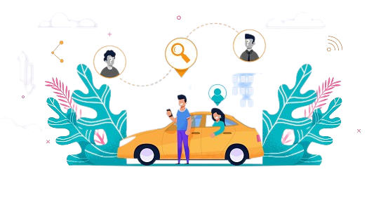
Introduction
Nowadays people are not connected
to each other even if they belong to
same company or same area.
For the same reason many people
are not aware about the routes their
colleagues share.
We want to develop such app
that connect such people and reduce
traffic congestion and environmental
pollution to some extent.

Slide 4




Limitations of existing systems
Both work at same company
Both share same (or partial same) route to their destination
They are not aware about this and booked cab individually
Even pooling option of both app is not able to suggest the customer as both app may not be sharing the data.
XYZ Company

Slide 5
Proposed solution
OLA
RAPIDO
UBER
Public Transport/ Private Vehicle
Both are connected through Trippify
Now they can share any mode of transportation
Interaction with colleague will make journey even happier and safer ☺
Sharing
Trippify
XYZ Company

Slide 6
User
Registration
Not allowed to use all the features.
Registered user
Allowed to send request for authentication
Authenticated User
Allowed to use all the features
Request
Approve
Authentication Authority
Check the profile of user and approve him/her.

Slide 7




User wants to share ride
Turn on availability status. Check suggestion
Whose availability status is on
Chat

Slide 8

Objectives
Connect those colleagues who share same (or partial same) route of transportation.
Reduce traffic congestion to some extent
Reduce pollution
Increase fuel efficiency by sharing mode
of transportation
Make connections with people from your
organization
Save travel cost
Safe vehicle sharing

Slide 9

Features
Registration
Request to authentication authority
Login
Colleagues suggestion
Chat box
Profile customization

Slide 10




Tools and technology
Web development technology
HTML
CSS
JavaScript
MongoDB
Express js
React js
Node js
Version control system
Git
Github

Slide 11
Highlights of our work
Authentication(bcryptjs, JWT secret code)
Registration
Login
Automatic Location Detection - OpenCage Geocoding API, Geolocation API
Chat Functionality - Socket.io
Validation – express-validator
Frontend – Material UI

Slide 12
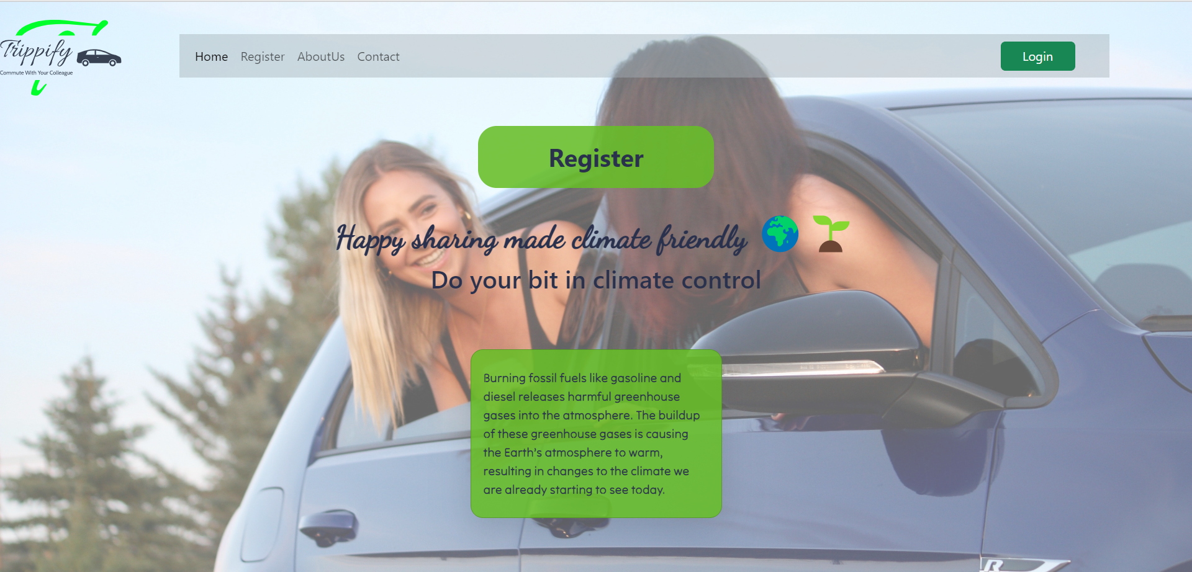
Snapshots of work
Fig 1 Home Page

Slide 13
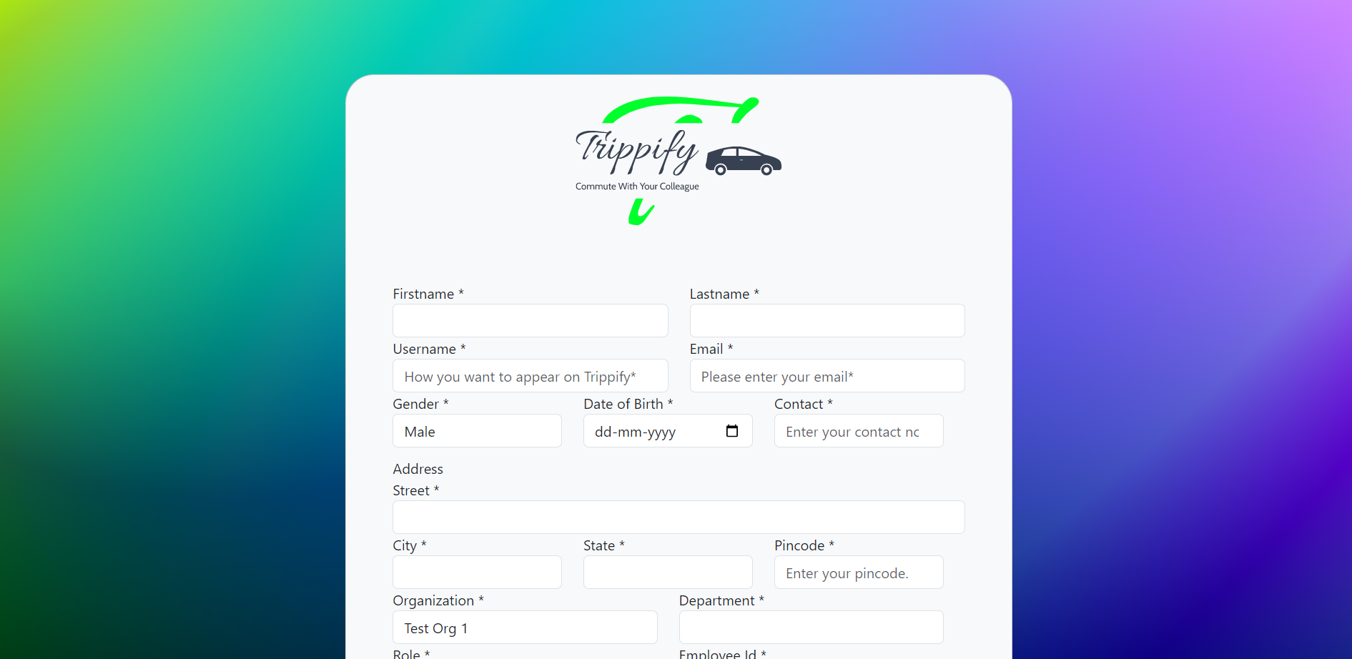

Fig 1 Home Page
Fig 2 Registration

Slide 14
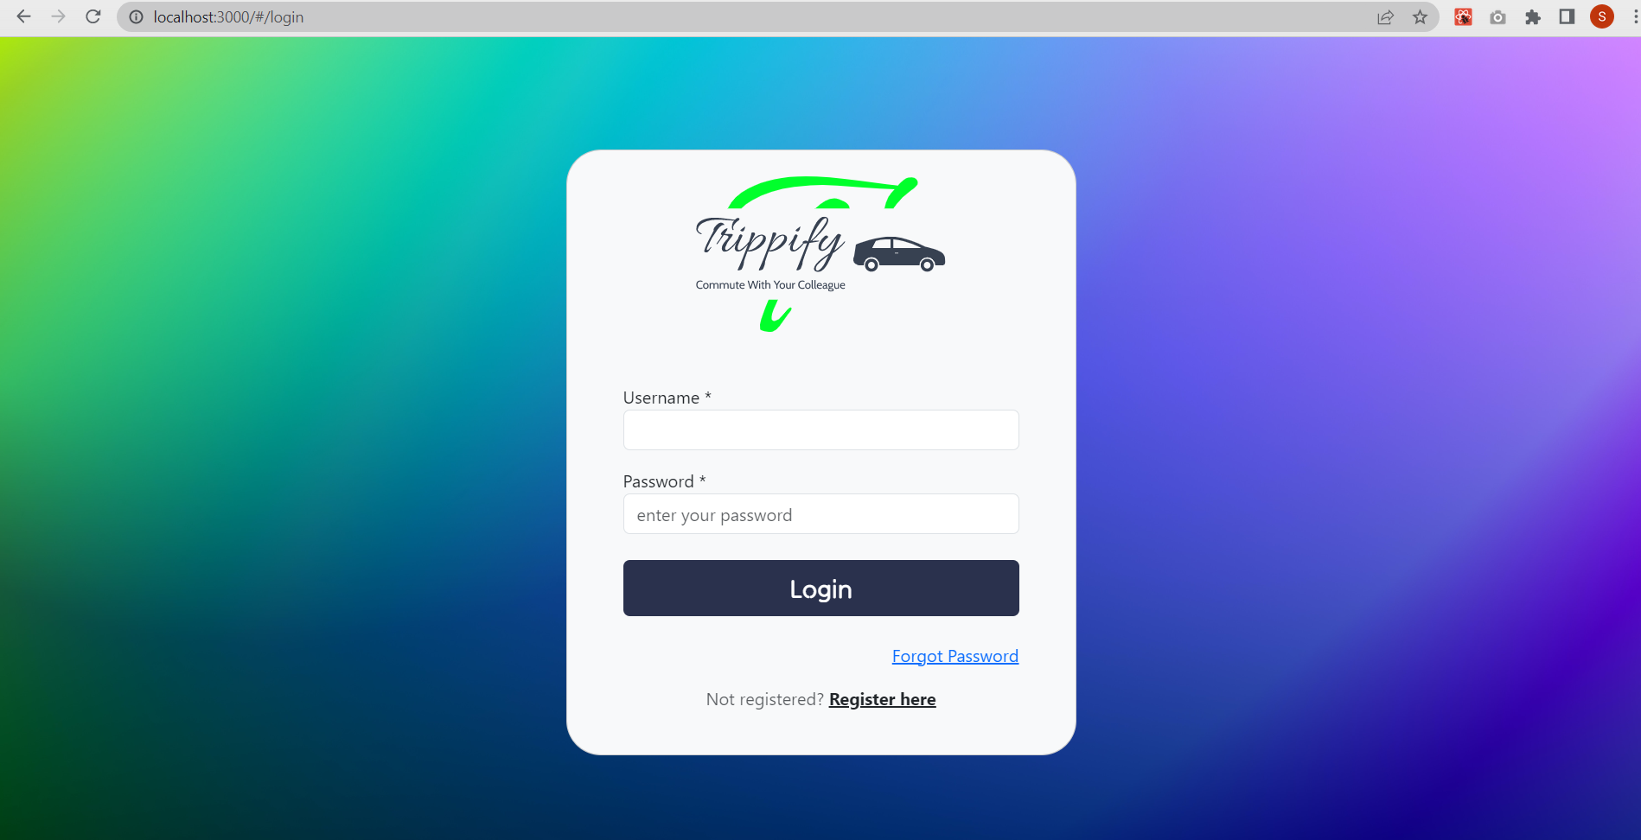
Fig 3 Login

Slide 15
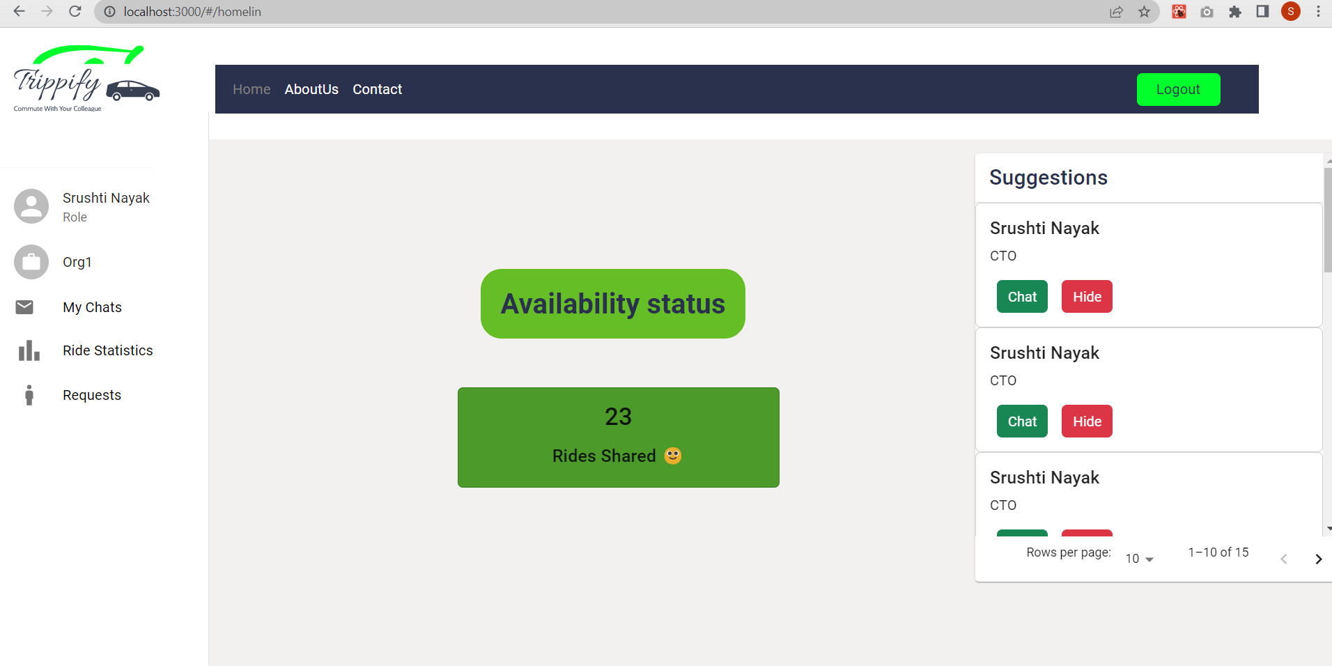
Fig 4 Main Page

Slide 16
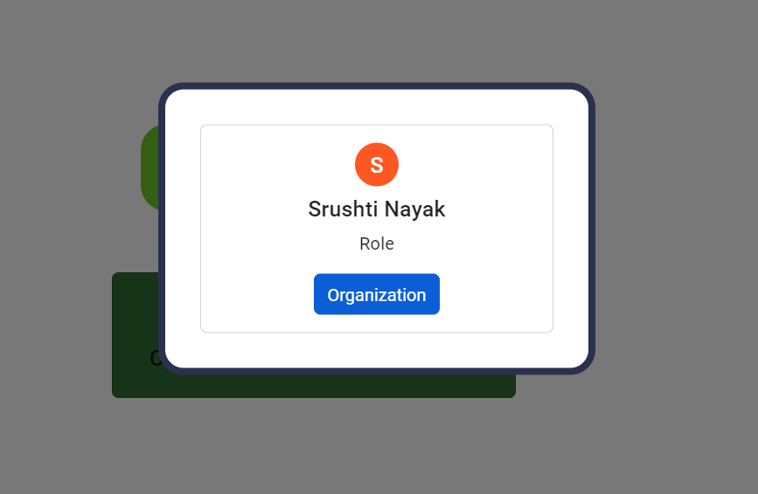
Fig 5 Suggestions

Slide 17
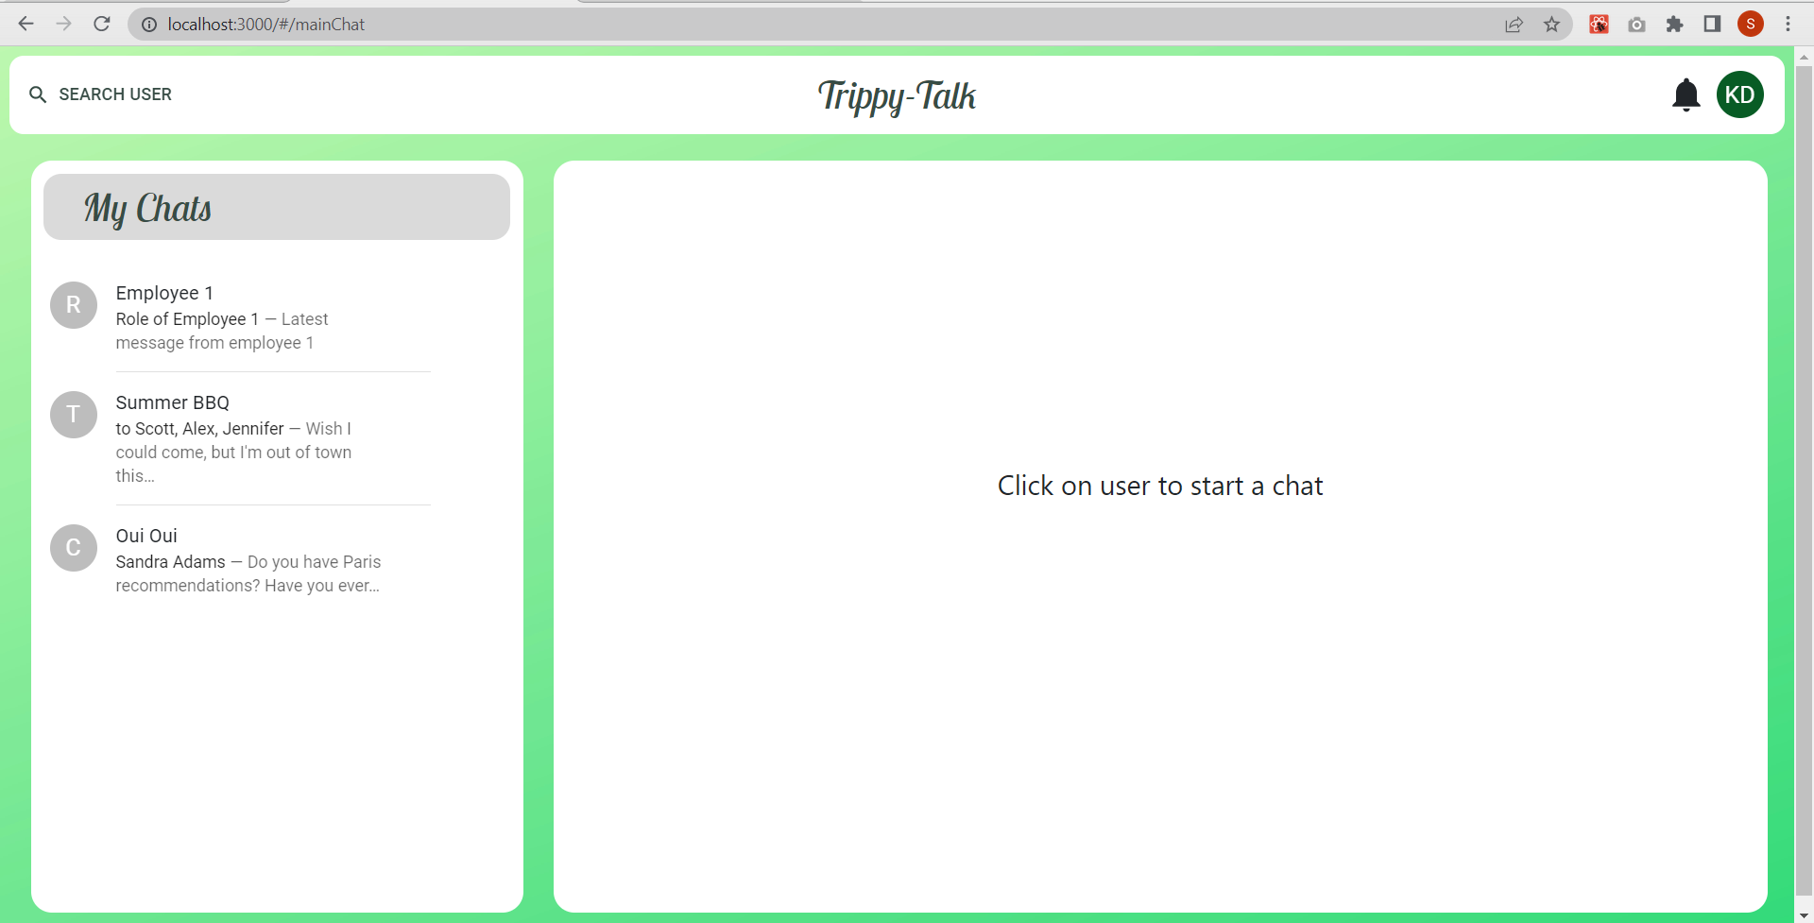
Fig 6 Chat

Slide 18
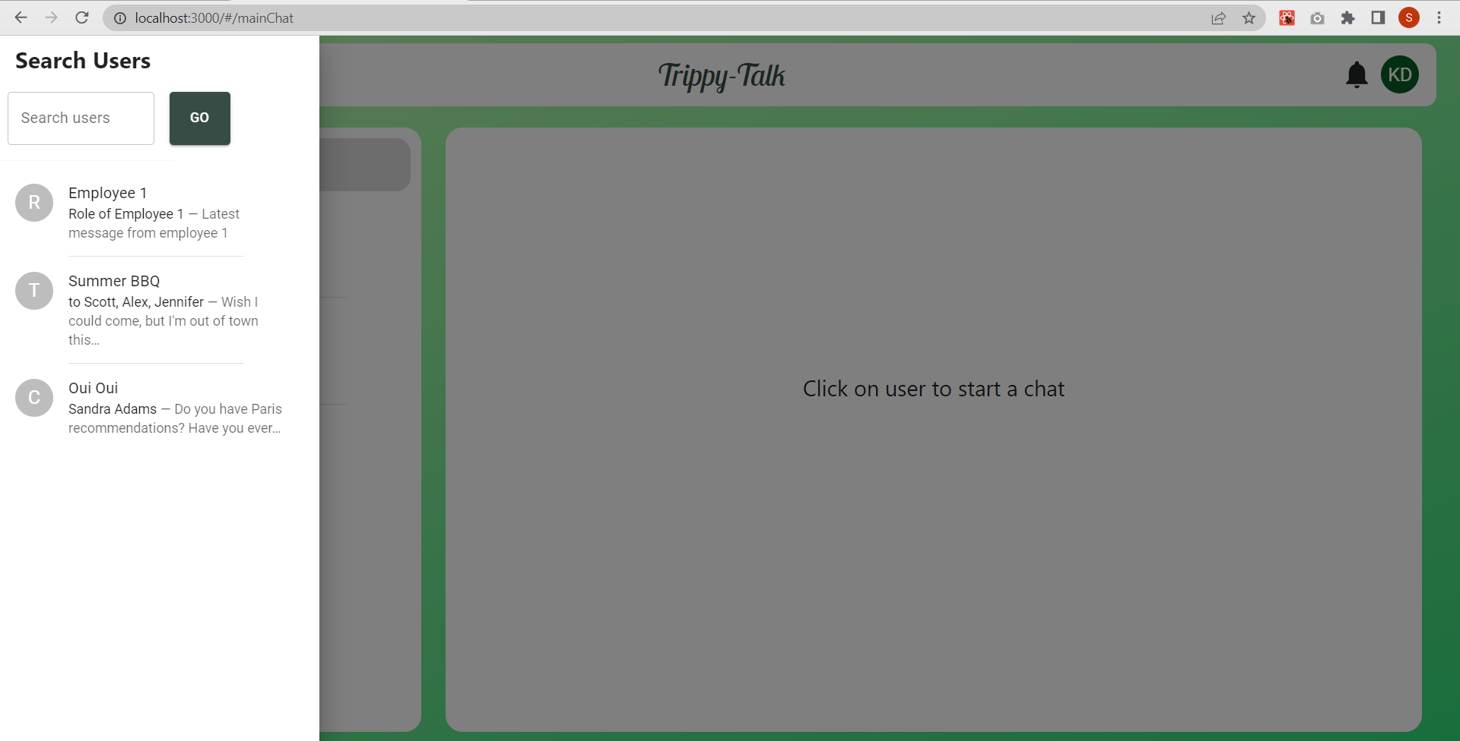
Fig 7 Chat

Slide 19
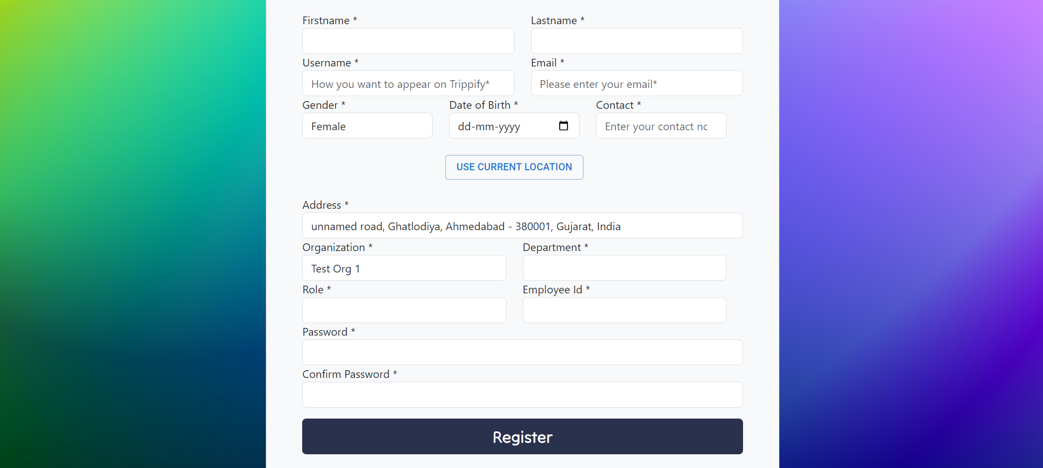
Fig 8 Location Functionality

Slide 20
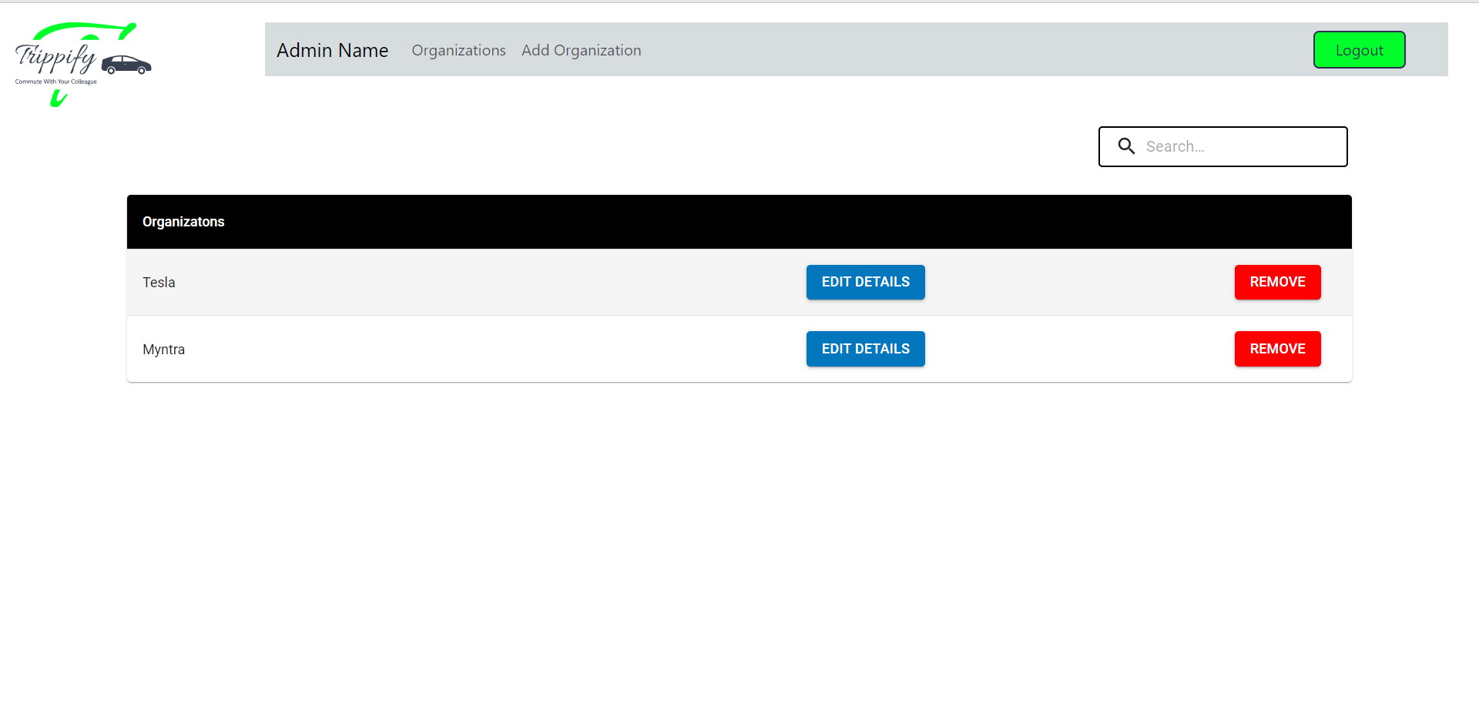
Fig 9 Admin Panel

Slide 21
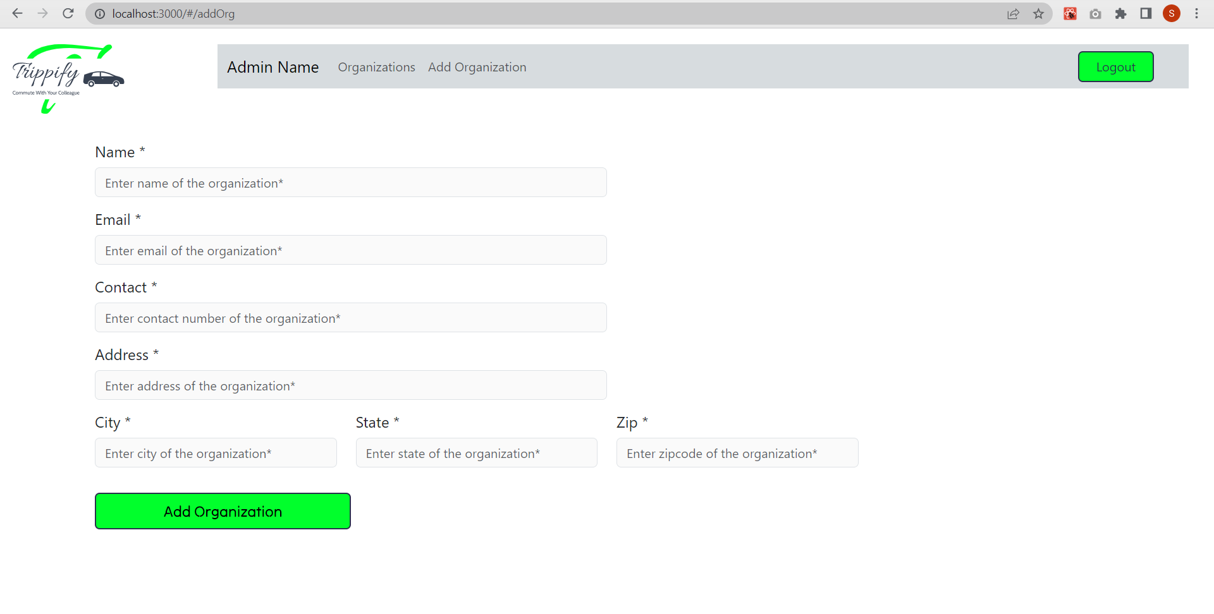
Fig 10 Admin Panel- Add organization

Slide 22
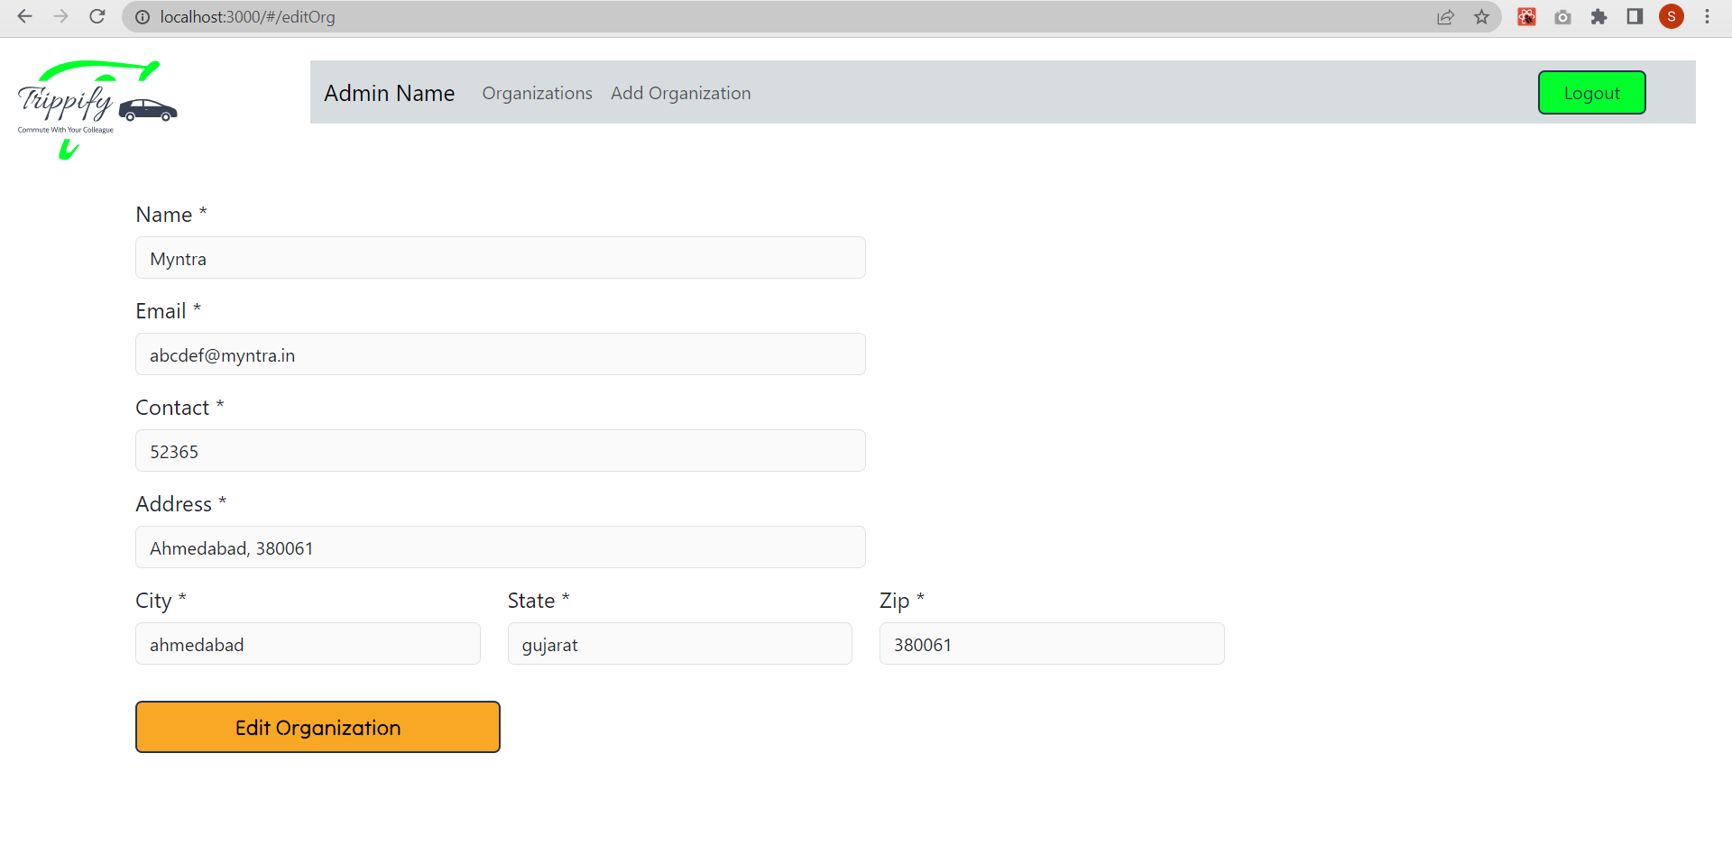
Fig 10 Admin Panel- Edit organization

Slide 23
Conclusion & Future work
The Trippify project has successfully addressed the challenges of commuting and traffic congestion within large organizations.
Through the development of a feature-rich web application using the MERN stack, the project has provided employees with innovative solutions for ride-sharing, transportation optimization, and enhanced user experience.
The emphasis on safety, privacy, and user-centric design has contributed to creating a secure and user-friendly platform.
Moving forward, potential future aspects include scalability and integration, smart mobility features, advanced analytics, and partnerships to further enhance the impact of the Trippify project.

Slide 24
References
Yan Huang et al., “Noah: A Dynamic Ridesharing System”, June - 2013.
Software Engineering A PRACTITIONER ’ S APPROACH SEVENTH EDITION Roger S. Pressman, Ph.D.
Dynamic Ridesharing Practice and Future Directions”, EURO Journal on Transportation and Logistics manuscript.
https://www.w3schools.com/

Slide 25
THANK YOU!!

